Slide 1
Phylogenetic trees
CMSC423 Intro. to Bioinformatics
Slides from Sushmita Roy @ U. Wisconsin

Slide 2
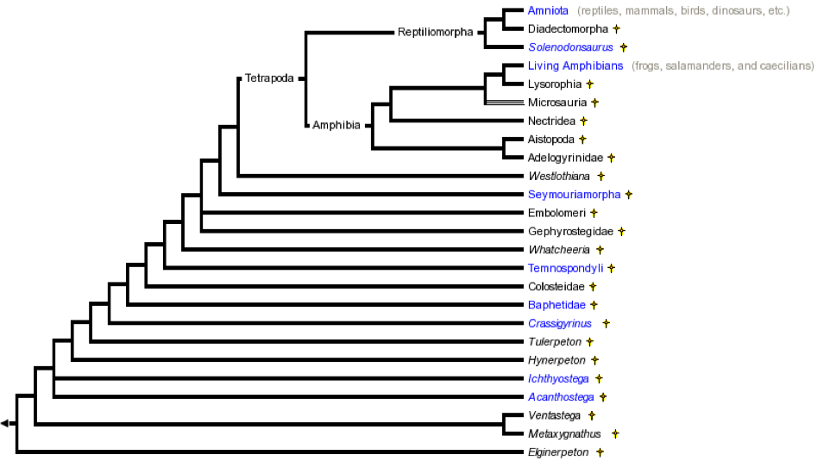
Modeling how evolution works

Slide 3
Understanding Populations

Slide 4
Anatomy of a tree

Slide 5
Phylogeny Questions
Given several organisms & a set of features (characters), usually sequence, but can be any trait (e.g., beak size for birds)
A: Given a phylogenetic tree, figure out what the ancestors looked like (what are the features of internal nodes)
Relatively easy, can be done with dynamic programming

Slide 6
Phylogeny Questions
Given several organisms & a set of features (characters), usually sequence, but can be any trait (e.g., beak size for birds)
B: Find the phylogenetic tree that best describes the evolutionary history of the organisms
Much harder: very large search space
possible rooted trees with n leaves

Slide 7
Phylogeny Questions
Given several organisms & a set of features (characters), usually sequence, but can be any trait (e.g., beak size for birds)
B: Find the phylogenetic tree that best describes the evolutionary history of the organisms
Much harder: very large search space

Slide 8
Phylogenetic tree construction
Parsimony methods
Distance-based methods

Slide 9
Parsimony
Given character data at leaf nodes, find the tree that has the smallest cost
Cost of a tree is determined by the number of substitutions
Best tree->lowest cost-> lowest number of substitutions
Hence there are two problems to finding the best tree
How to compute the cost of a tree
How to search the space of trees

Slide 10
Defining cost of a tree
Assume a set of aligned sequences
Each sequence corresponds to a leaf in a tree
Assume sites are independent of each other
Estimate cost per site
For any possible tree for these sequences, estimate the number of changes needed to produce sequences at each site
Sum over all sites

Slide 11
Defining the cost of a tree
AAA
AAA
AAA
1
AAA
AGA
AAA
AAA
AAA
AAA
1
2
1
1
1
2
1
1
AAG
AAA
GGA
AGA
AAG
AGA
AAA
GGA
AAG
GGA
AAA
AGA

Slide 12
How to compute the cost of a tree?
Weighted parsimony
Assume we have a substitution matrix that gives us the cost of switching between two different bases
There is a recursive algorithm that allows us to compute the cost of the tree

Slide 13
Weighted Parsimony
Remember we only see things at the leaves
Need to consider all possible ways in which we could see something at the leaves and consider the one with the smallest number of substitutions
Weighted Parsimony uses a Dynamic Programming idea on trees
Performs a bottom up tree traversal to compute minimal cost at a node based on its children
Re-use computation done for the children
Thus if we had n extant nodes, n-1 internal nodes, and m letters in our alphabet we will compute (2n-1)*m numbers

Slide 14
Weighted Parsimony notation
Let C_{k}(a) be the minimal cost of observing a at node k
Let x^{k} denote letter in the k^{th} node
Assume our tree has n nodes
Let S(a,b) be the cost of switching from a to b where a, b are in our alphabet
An internal node k’s children are referred to as i and j

Slide 15
Weighted Parsimony algorithm
Initialization
Recursion
If k is a leaf node
Otherwise
Compute C_{i}(a) and C_{j}(a) for all a, for k’s daughter nodes i and j
Termination
Tree cost=min_{a}C_{2n-1}(a)

Slide 16
Weighted parsimony example
 | A | C | G | T
A | 0 | 0.8 | 0.2 | 0.9
C | 0.8 | 0 | 0.7 | 0.5
G | 0.2 | 0.7 | 0 | 0.1
T | 0.9 | 0.5 | 0.1 | 0
5
4
1
2
3
A
C
T
Estimate the cost of this tree using the substitution matrix.

Slide 17
Weighted Parsimony example

Slide 18
Parsimony can be used to reconstruct ancestral states as well
This requires a small modification to the algorithm
Just keep track of the value that gave the smallest cost as well in addition to the cost
Let k be an internal node
Let i and j be k’s children
Introduce pointers
Update these additional pointers at the end of recursion step
Trace back then looks at these values to reconstruct the ancestral state

Slide 19
Weighted Parsimony modification to keep track of ancestral states
Initialization
Recursion
If k is a leaf node
Otherwise
Compute C_{i}(a) and C_{j}(a) for all a, for k’s daughter nodes i and j
Termination
Tree cost=min_{a}C_{2n-1}(a)

Slide 20
Example to infer the ancestral states
 | A | C | G | T
A | 0 | 0.8 | 0.2 | 0.9
C | 0.8 | 0 | 0.7 | 0.5
G | 0.2 | 0.7 | 0 | 0.1
T | 0.9 | 0.5 | 0.1 | 0
5
4
1
2
3
A
C
T
What is the ancestral state associated with the minimal cost tree?

Slide 21
Parsimony
Often people use the simpler version of parsimony where there is no substitution matrix
This is equivalent to S(a,a)=0 and S(a,b)=1 where a!=b

Slide 22
Searching the space of possible trees
We know how to score a given tree
But how to search the space of trees?
Heuristic methods
Start with a tree
Make small changes to the tree and check for improvements in score
Branch and bound methods
Adding a sequence cannot decrease the cost of the tree
Thus if we have the cost of the best complete tree so far, any partial tree with cost greater than the current best tree is not worth exploring

Slide 23
Heuristic methods
Nearest neighbor interchange
For any given tree we can go to three neighboring trees that differ in the branching of one branch
Subtree pruning and regrafting
Delete an internal branch to get two subtrees
Add one subtree to the other subtree by considering other branches

Slide 24
Nearest neighbor interchange
A
D
A
B
A
B
B
C
D
C
C
D
Every internal branch has three possible topologies for four nodes.
Nearest neighbor interchange moves between these three topologies.

Slide 25
Subtree pruning and regrafting
G
F
G
F
A
A
E
E
Delete branch
B
D
B
D
C
C
Old tree
New tree

Slide 26
Branch and bound methods
Branch and bound methods
Systematically enumerate solutions, and discards avenues that are guaranteed to have higher costs
Lower bound
For a set of numbers, the lower bound of the set is the smallest number in the set
The cost of a partial tree, T provides a lower bound for all trees possible from T
Search by repeatedly selecting the partial tree with the lowest lower bound

Slide 27
Branch and bound methods
1
5
3
1
4
4
3
2
1
3
2
2
4
5
1
3
1
5
3
1
3
4
4
2
2
2
1
3
4
1
2
5
1
3
3
2
4
4
2
5

Slide 28
Branch and bound algorithm for Phylogenetic tree search
Make an initial tree T with all leaves L.
Initialize Q to a tree with three leaves in L
Repeat
Set T_{new} to tree with lowest cost in Q
If T_{new} has all leaves return
Else
Generate new trees by considering remaining leaves for each branch of T_{new}
Compute cost for each new tree
If Cost(new tree)<Cost(T) add it to Q in sorted order of cost

Slide 29
Comments on branch and bound
Exact method
May be more efficient than exhaustive
Worst case is no better
Efficiency depends on
tightness of the lower bound
quality of initial tree

Slide 30
Distance-based vs Parsimony methods
Different methods for phylogenetic tree reconstruction
Distance based methods
UPGMA
Neighbor Joining
Parsimony methods
Enables also estimation of the ancestral sequences
No emphasis on branch length estimation
Distance-based are faster
Parsimony gives ancestral sequence
Does not assume anything on branch lengths

